Slide 1
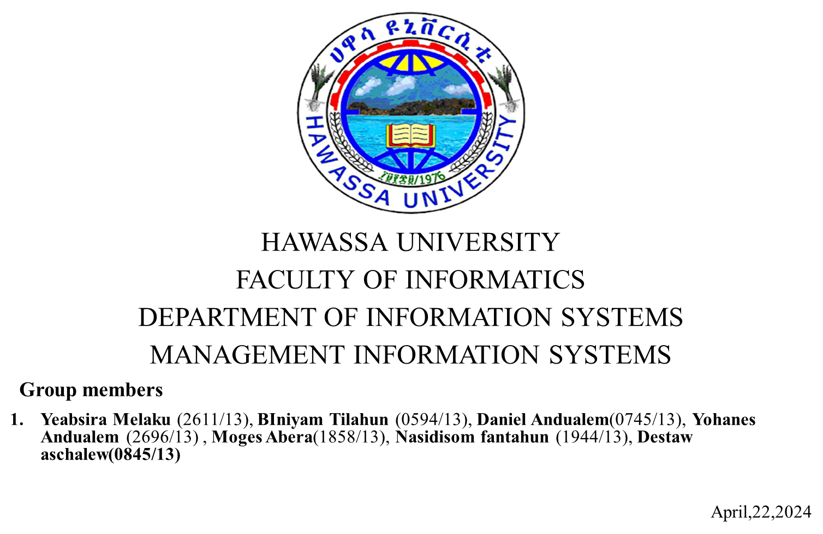

Slide 2
Titles for discussion
Telecommunications, the Internet, and Wireless Technology
Securing Information systems

Slide 3
Telecommunications, the Internet, and Wireless Technology Sub topics:
TELECOMMUNICATIONS AND NETWORKING IN TODAY’S BUSINESS WORLD
COMMUNICATIONS NETWORKS
THE GLOBAL INTERNET
THE WIRELESS REVOLUTION

Slide 4

TELECOMMUNICATIONS AND NETWORKING IN TODAY’S BUSINESS WORLD
1

Slide 5
Networking and Communication Trends
Telephone and computer networks used to be separate for voice and data.
Now, they're merging into one digital network using Internet standards.
This shift allows to offer various services like data transmission and TV programming.
This advancements have made networks faster, cheaper, and more portable, with a growing reliance on wireless platforms like smartphones.
2

Slide 6
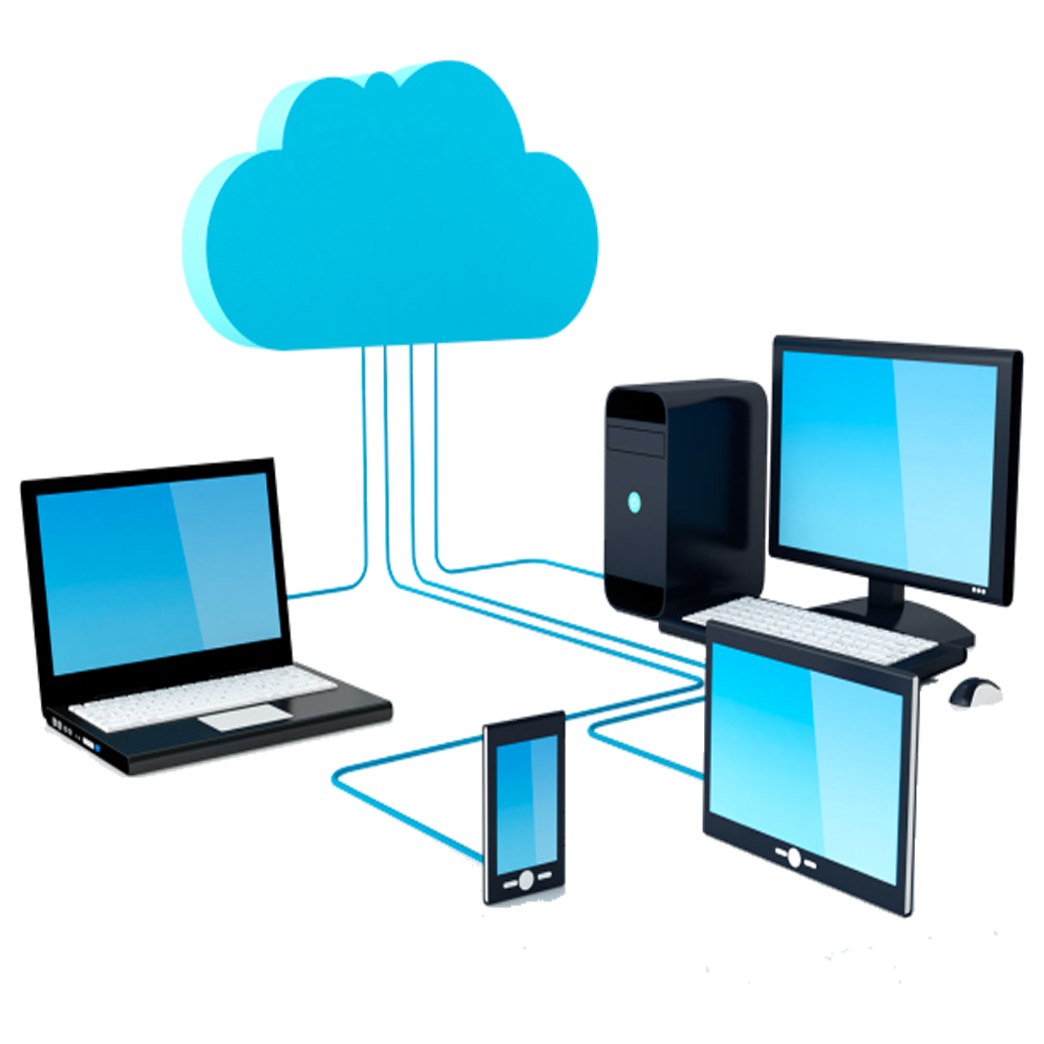
What is computer network?
3

Slide 7
Computer network
connects two or more computers
consists of hardware like client and server computers, network interfaces, and a connection medium.
The network O.S manages communications and resources.
Additionally, networks often include switches or hubs for connectivity, and routers
4

Slide 8
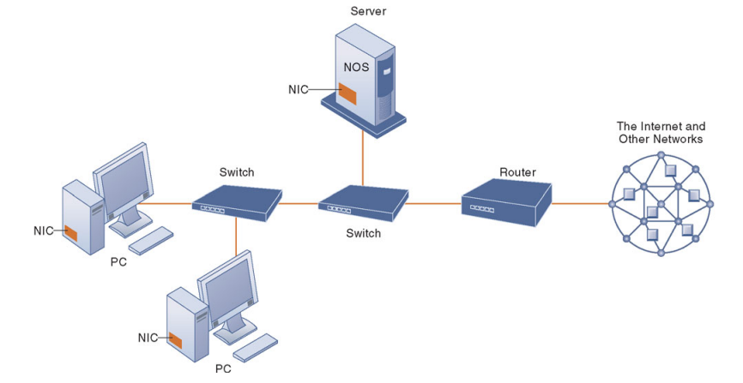
Components of a simple computer network
5

Slide 9
Key digital networking technologies
Key digital networking technologies encompass client/server computing, packet switching, and the TCP/IP protocol suite
Client/server computing over a network.
Packet switching optimizes data transmission by breaking messages into packets and routing them independently.
TCP/IP standardizes communication protocols, enabling seamless connectivity .
6

Slide 10
SIGNALS: DIGITAL VS. ANALOG
Network communication involves analog or digital signals.
Analog signals are continuous waveforms used in voice communication.
Digital signals, represented by binary states, require modems to convert them for transmission over analog networks.
7

Slide 11
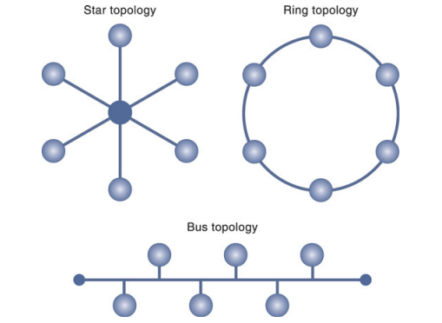
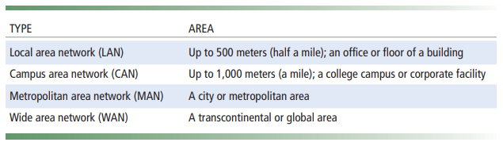
Types of net. and topology
8

Slide 12
PHYSICAL TRANSMISSION MEDIA
Twisted Wire
Coaxial Cable
Fiber Optics and Optical Networks
Wireless Transmission Media
9

Slide 13

The internet
Users connect through Internet service providers (ISPs), accessing various connection options like DSL, cable, or satellite.
Internet governance involves professional organizations like ICANN and government bodies.
10

Slide 14
The wireless revolution
The wireless revolution has transformed devices into portable computing platforms.
Businesses benefit from wireless communication for better connectivity.
Digital cellular services like GSM and CDMA offer high-speed transmission.
3G networks provide broadband Internet access.
11

Slide 15
Conti.
Wi-Fi and Bluetooth enable wireless Internet access.
WiMax extends wireless Internet access to areas without traditional broadband connectivity.
RFID systems track goods in the supply chain.
Wireless sensor networks monitor various applications.
12

Slide 16
Securing Information systems

Slide 17
Sub contents
SYSTEM VULNERABILITY AND ABUSE
BUSINESS VALUE OF SECURITY AND CONTROL
ESTABLISHING A FRAMEWORK FOR SECURITY AND CONTROL
TECHNOLOGIES AND TOOLS FOR PROTECTING INFORMATION RESOURCES

Slide 18

What is security and what is control?
13

Slide 19
Definition:
Security refers to the policies, procedures, and technical measures used to prevent unauthorized access, alteration, theft, or physical damage to information systems.
Controls are methods, policies, and organizational procedures that ensure the safety , the accuracy and reliability of its records and assets
14

Slide 20
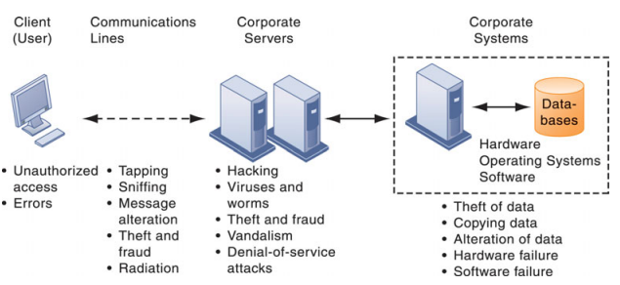
CONTEMPORARY SECURITY CHALLENGES AND VULNERABILITIES
15

Slide 21
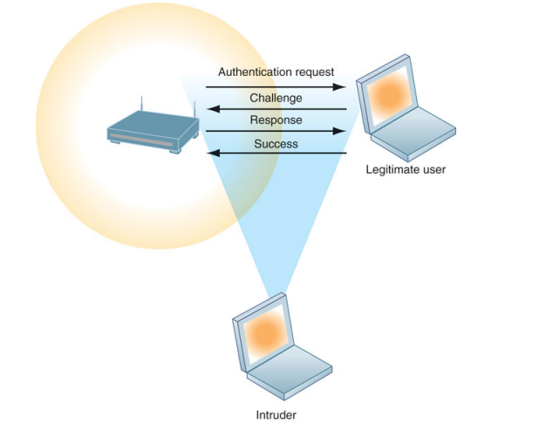
WIRELESS SECURITY CHALLENGES
16

Slide 22
The internet abuse
Hackers exploit weaknesses in computer systems for unauthorized access.
Their activities extend from system intrusion to theft of goods and information, as well as cyber-vandalism.
Spoofing and sniffing are common tactics used to hide identities and eavesdrop on networks, respectively.
Denial-of-service (DoS) attacks flood servers with false communications, rendering them unavailable to legitimate users.
17

Slide 23
Conti.
Identity theft, especially online, has surged, facilitated by tactics like phishing and pharming.
Internal threats from employees and software vulnerabilities further compound the challenges in maintaining information security.
18

Slide 24
Business value of security and control
Security and control measures are crucial for protecting valuable information assets stored in systems.
Legal and regulatory requirements mandate firms to ensure data protection and privacy, with laws like HIPAA, Gramm-Leach-Bliley Act, and Sarbanes-Oxley Act imposing strict standards.
Compliance with these regulations necessitates robust security frameworks
Additionally, firms must be prepared to respond to legal actions with effective electronic records management and computer forensics capabilities.
19

Slide 25
Establishing a frame work for security and control
20

Slide 26
GENERAL CONTROLS
Software controls
Hardware controls
Computer operations controls
Data security controls
Implementation controls
Administrative controls
21

Slide 27
Conti.
RISK ASSESSMENT
SECURITY POLICY
DISASTER RECOVERY PLANNING AND BUSINESS CONTINUITY PLANNING
22

Slide 28
TECHNOLOGIES AND TOOLS FOR PROTECTING INFORMATION RESOURCES
Businesses employ various technologies to protect their information resources, including identity management tools
Authentication ensures that users are who they claim to be, often through passwords, though new technologies like tokens, smart cards, and biometric authentication offer more secure alternatives.
Firewalls, intrusion detection systems, and antivirus software are crucial for safeguarding against malware and unauthorized access
Encryption, utilizing methods like SSL/TLS and public key infrastructure, protects data during transmission and storage, while fault-tolerant and high-availability computing systems
23

Slide 29
Conti.
Encryption, utilizing methods like SSL/TLS and public key infrastructure, protects data during transmission and storage, while fault-tolerant
Cloud computing and mobile platforms present new security challenges, requiring careful consideration
Security outsourcing to managed security service providers (MSSPs).
24

Slide 30


